Slide 1
INTRODUCTION TO MRI
Lynne J. Williams, Ph.D.
BCCH MRI Research Facility
May 8, 2018
Structural MRI

Slide 2

LAB SESSIONS
Wednesdays (11 to 12)
https://bluejeans.com/320270335
Fridays (10 to 11)
https://bluejeans.com/663641726

Slide 3

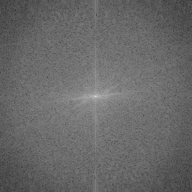
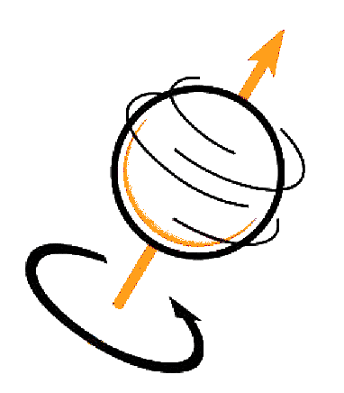
REVIEW
PROTONS PRECESS
PROTON RELEASE ENERGY
DATA GETS STORED IN K-SPACE
Spin (aka angular momentum) generates a magnetic moment that allows protons to precess at a specific resonance (Larmor) frequency in an external magnetic field (B₀)
Radio frequency (B₁) waves knock over the aligned, precessing protons. When the protons realign with B₀, they release energy at the resonance (Larmor) frequency
The relaxation rates (return to alignment with B₀) are recorded in K-space as a spatial frequencies (number of cycles per meter)

Slide 4
REVIEW
QUESTIONS?

Slide 5
WEEK 2
STRUCTURAL MRI
TODAY’S CLASS
What is relaxation (and why we need to know)?
What do MR parameters mean?
Why should we care about Quality Control?
MRI Scans gone bad (aka Artifacts)

Slide 6
WEEK 2
STRUCTURAL MRI
STRUCTURAL MRI
RELAXATION
T1, T2 & T2*
Lynne J. Williams, Ph.D.
BCCH MRI Research Facility

Slide 7
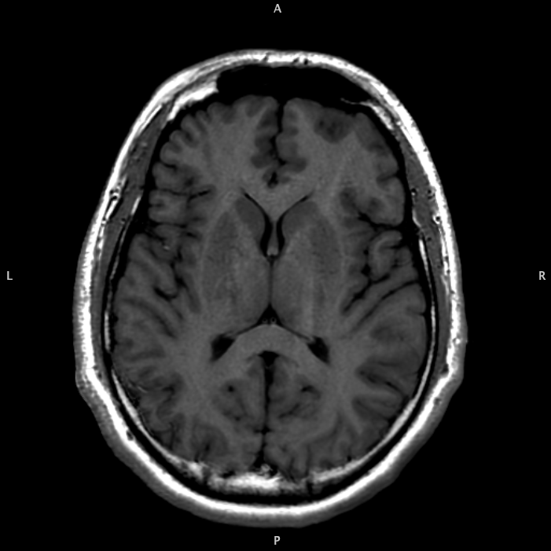
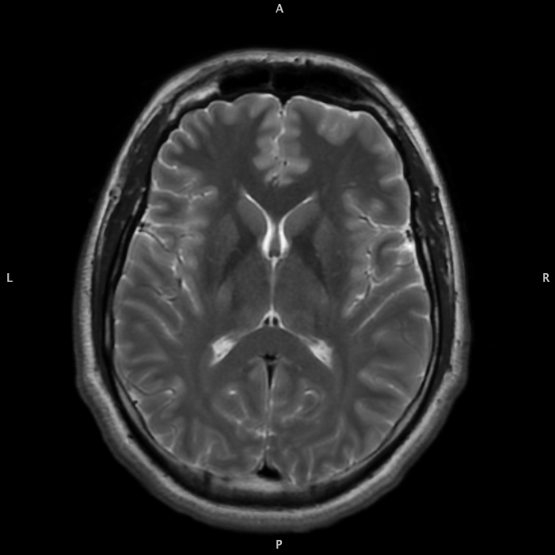
T1 (LONGITUDINAL) VS
T2 (TRANSVERSE)
RELAXATION
T1 and T2 are magnetic timing parameters that differ between tissue types
They are used as a source of contrast
The T1 and T2 time constants dictate the shape of the exponential recovery and decay curves of the longitudinal and transverse magnetization
T1
Slide / 01
www.yourwebsite.com
T2

Slide 8
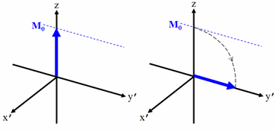
B₀
RECALL
RF PULSES
“KNOCK OVER”
PROTONS
Protons lined up with B0 get knocked over by an RF pulse
M is the net magnetization of all protons
M₀ is the maximum net magnetization

Slide 9
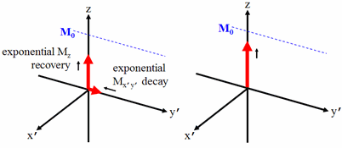
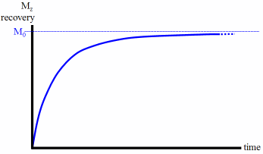
63% recovery
T1 time constant

Slide 10
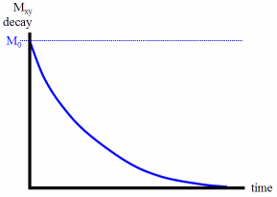
37% decay
T2 time
constant

Slide 11
DECAY AND
REGROWTH ARE
SEPARATE
PROCESSES
The decay of M_{xy} and the regrowth of M_{z} should be considered separate processes.
The net magnetization vector is the vector sum of these two processes.
M_{xy} decay occurs faster than M_{z} recovery
M_{xy} decay can occur without M_{z} recovery, but the opposite is not true
Slide / 01
www.yourwebsite.com

Slide 12
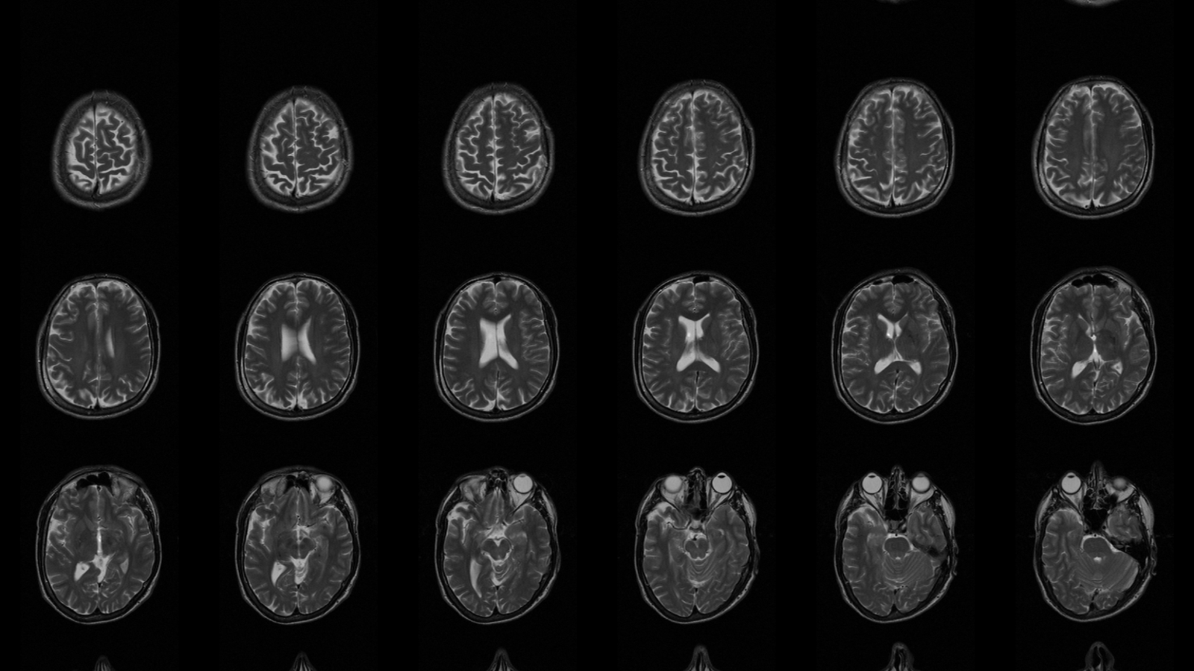
T2 and T2*
T2
T2*
T2 dephasing includes only
irreversible sources of loss
of phase coherence
T2* dephasing also includes additional sources of loss of
phase coherence (e.g.,
magnetic field
inhomogeneities and
susceptibility)
Notes:
T2 dephasing
Spin-spin interactions at the molecular level changes the frequency of precession and protons move out of phase
The spins (protons) go out of phase in the transverse plane when the Rf pulse is switched off. This dephasing is due to static magnetic field inhomogeneities intrinsic (i.e. susceptibility changes at tissue interfaces) and extrinsic (i.e. field inhomogeneities of the main magnetic field) to the examined object.
T2*
This causes changes to the frequency of precession at the molecular level and protons move out of phase even quicker

Slide 13
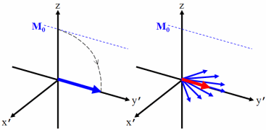
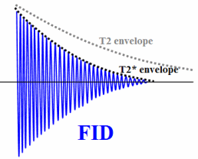
ADDITIONAL DEPHASING OCCURS DUE TO MAGNETIC FIELD INHOMOGENEIT-IES AND SUSCEPTIBILITY
THEREFORE, FID
OSCILLATES AT THE
RESONANCE (LARMOR)
FREQUENCY, BUT IS
DAMPENED
BY T2* DECAY
(Free Induction Decay)

Slide 14
WEEK 2
STRUCTURAL MRI
STRUCTURAL MRI
SCAN PARAMETERS

Slide 15
MRI
PARAMETERS

Slide 16
MRI
PARAMETERS
FLIP ANGLE
Amount of rotation of the magnetization vector produced by an RF pulse (B₁) with respect to the direction of the static magnetic field (B₀).
- Hendrick RE (Ed). Glossary of MR Terms (5th Ed). Reston, VA: American College of Radiology 2005
Slide / 01

Slide 17
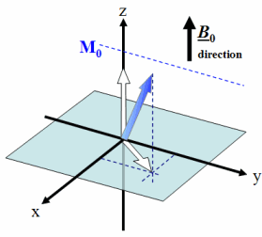
PARTIAL
VS 90°
FLIP
ANGLE
Image from Revise MRI

Slide 18
MRI
PARAMETERS
ECHO
An echo is the emission of energy in the form of an electromagnetic resonance signal of nuclei after its excitation.
MR Technology Information Portal
Notes:
Partial echo vs full echo. Partial echo is when the pre-dephasing lobe of the readout gradient is reduced, meaning the readout won't start as far out in k-space. Then the missing data points are synthesised using the conjugate symmetry of k-space. The result is decreased SNR, but a shorter minimum TE because less time is used in the readout before k0 is acquired.

Slide 19
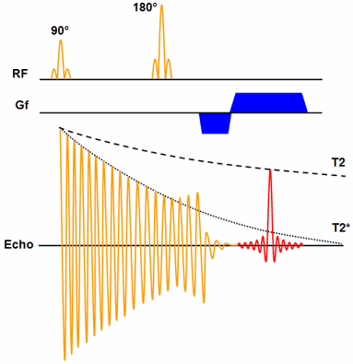
SPIN
ECHO
The spin echo pulse sequence has a 90° excitation pulse and refocuses some of the dephasing with a 180° refocusing RF pulse.
Image from Revise MRI
Notes:
The spin echo pulse sequence has a 90° excitation pulse (GE has a small excitation pulse), and SE refocuses some of the dephasing which occurs during the echo time using a 180° refocusing RF pulse. A GE does not have the 180°.

Slide 20
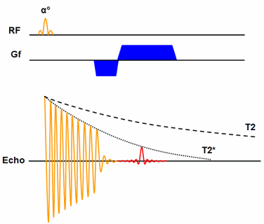
GRADIENT SPIN
ECHO
Image from Revise MRI

Slide 21
MRI
PARAMETERS
ECHO TIME (TE)
The echo time (TE) represents the time from the centre of the RF-pulse to the centre of the echo.
- Revise MRI
Slide / 01

Slide 22
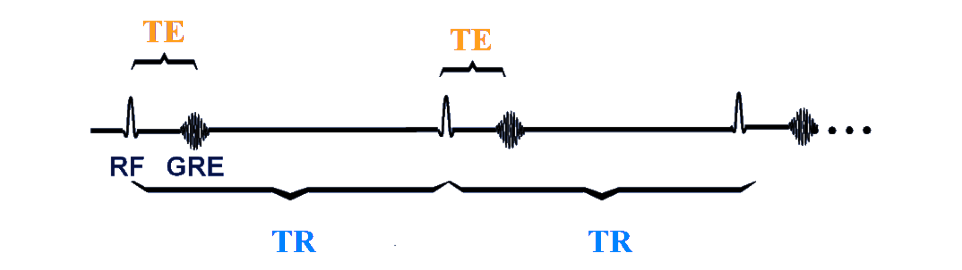
REPETITION TIME (TR)
& ECHO TIME (TE)

Slide 23
MRI
PARAMETERS
INVERSION TIME (TI)
In inversion recovery, time between middle of
inverting (180°) RF pulse and middle of the subsequent exciting (90°) pulse to detect amount of longitudinal magnetization
Slide / 01
- Hendrick RE (Ed). Glossary of MR Terms (5th Ed). Reston, VA: American College of Radiology 2005

Slide 24
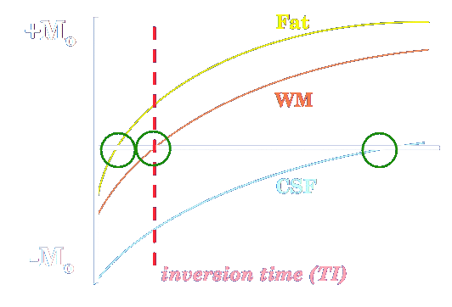
Notes:
The usual Inversion Recovery sequence begins with a 180°-inverting pulse
Reverses the longitudinal magnetization (M_{z}) for all tissues.
During the inversion time (TI) interval
M_{z} regrows via T1-relaxation to restore their equilibrium alignment in the +z-direction.
A spin echo (or more commonly a fast spin echo) sequence then generates a signal based on the longitudinal magnetization of each tissue at time TI
For tissues with M_{z} close to zero at time TI
Tissue produces little or no signal
Makes no significant contribution to the magnitude-reconstructed image

Slide 25
MRI
PARAMETERS
FIELD OF VIEW (FOV)
The rectangular region superimposed over the human body over which MRI data are acquired. Its dimensions are specified in length in each in-plane direction and are controlled by the application of frequency encode and phase-encode gradients.
Slide / 01
- Hendrick RE (Ed). Glossary of MR Terms (5th Ed). Reston, VA: American College of Radiology 2005

Slide 26
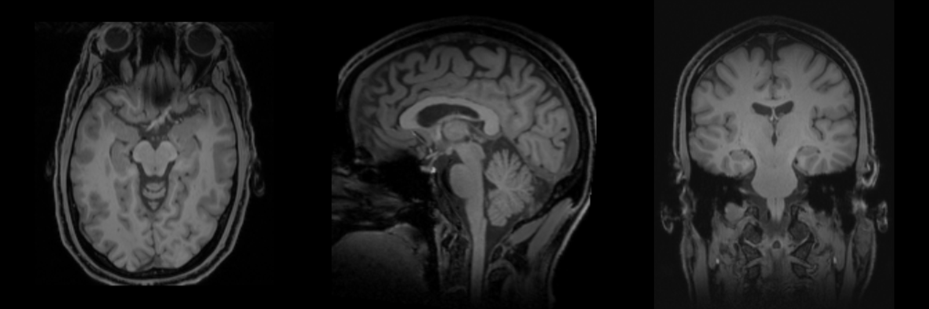
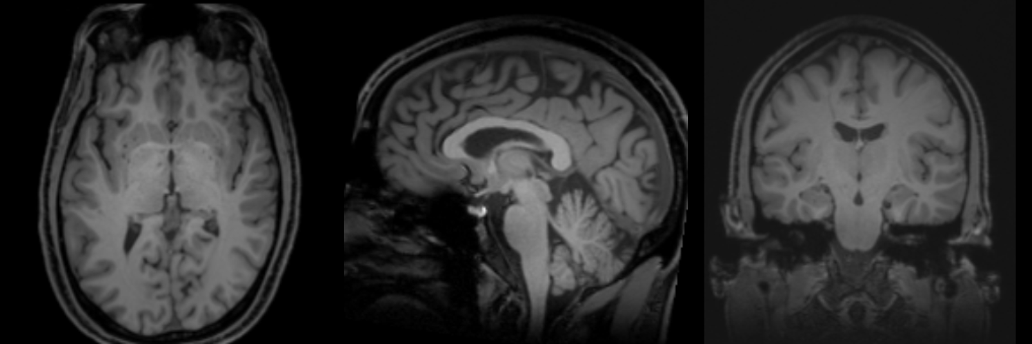

Slide 27
$ fslinfo STRUCT0000.nii.gz
data_type INT16
dim1 256
dim2 256
dim3 256
dim4 1
datatype 4
pixdim1 0.900000
pixdim2 0.900000
pixdim3 0.900000
pixdim4 1.000000
cal_max 928.0000
cal_min 0.0000
file_type NIFTI-1+
MATRIX SIZE
VOXEL DIMENSIONS
x = FOV_{x}/N_{x}
y = FOV_{y}/N_{y}
z_{3D} = FOV_{z}/N_{z}
z_{2D} = slice
thickness

Slide 28
MRI
PARAMETERS
SLICE THICKNESS
The thickness of a slice. As the slice profile may not be sharp edged, a criterion such as the distance between the points at half the sensitivity of the maximum (FWHM) or the equivalent rectangular width may be useful.
Slide / 01
- Hendrick RE (Ed). Glossary of MR Terms (5th Ed). Reston, VA: American College of Radiology 2005

Slide 29
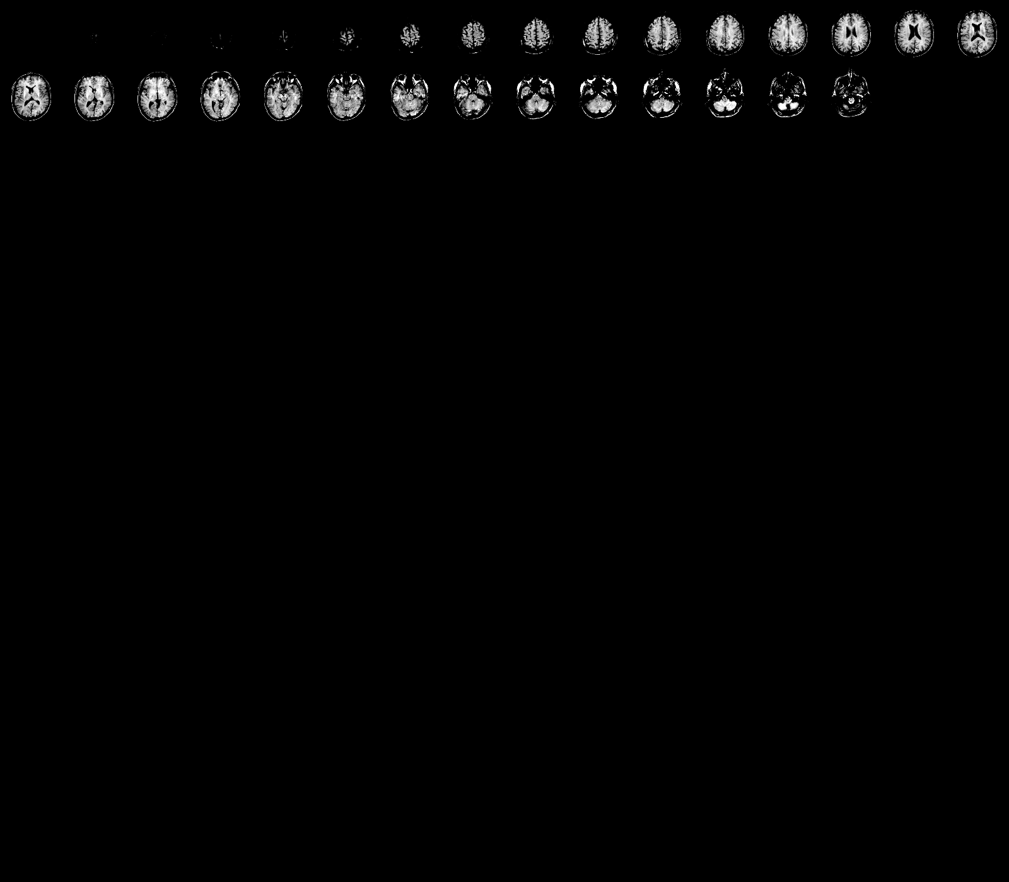
1 mm × 1 mm × 1 mm
.97 mm ×.97 mm × 5 mm
X
Y
Z
X
Y
Z
ISOTROPIC
ANISOTROPIC

Slide 30
$ fslinfo STRUCT0005.nii.gz
data_type INT16
dim1 174
dim2 192
dim3 224
dim4 1
datatype 4
pixdim1 1.000000
pixdim2 1.000000
pixdim3 1.000000
pixdim4 2.100000
cal_max 1931.0000
cal_min 0.0000
file_type NIFTI-1+
1 mm × 1mm × 1mm

Slide 31
$ fslinfo STRUCT0007.nii.gz
data_type INT16
dim1 256
dim2 256
dim3 30
dim4 1
datatype 4
pixdim1 0.976562
pixdim2 0.976562
pixdim3 5.000000
pixdim4 1.000000
cal_max 4095.0000
cal_min 0.0000
file_type NIFTI-1+
.97 mm ×.97 mm × 5 mm

Slide 32
WEEK 2
STRUCTURAL MRI
STRUCTURAL MRI
QUALITY CONTROL
Lynne J. Williams, Ph.D.
BCCH MRI Research Facility

Slide 33
RULE #1:
A GOOD OFFENCE
MAKES A
GOOD DEFENCE

CONTROL FOR
MOTION AT
THE SOURCE
https://hub.bcchr.ca/display/equip/MRI+Research+Facility+Frequently+Asked+Questions

Slide 34
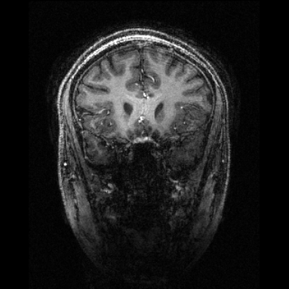
MOTION
ARTIFACT

Slide 35
RULE #2:
LOOK AT YOUR
DATA

THIS CAN DETERMINE STEPS IN YOUR PROCESSING PIPELINE

Slide 36
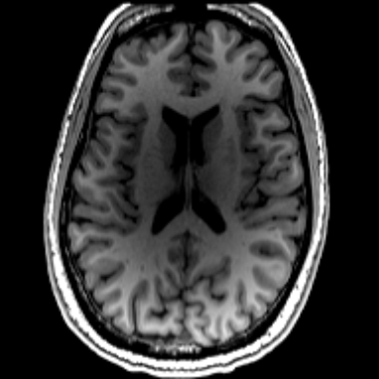
BIAS

Slide 37
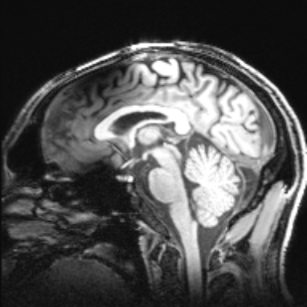
GRADIENT
NONLINEARITY
ARTIFACT
Expansion in the inferior regions

Slide 38
RULE #3:
LOOK AT YOUR
DATA

DETERMINES WHETHER THE DATA SHOULD BE INCLUDED IN THE ANALYSIS

Slide 39
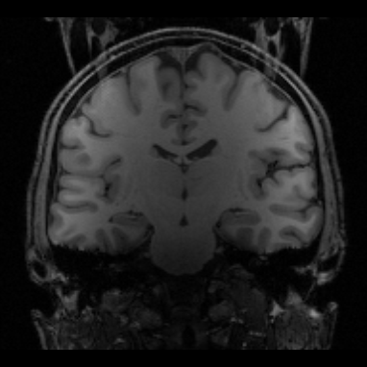
WRAP
ARTIFACT
Some of the signal from the neck overlaps with portions of the brain

Slide 40
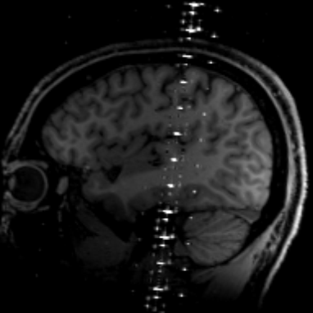
RF ZIPPER
ARTIFACT

Slide 41
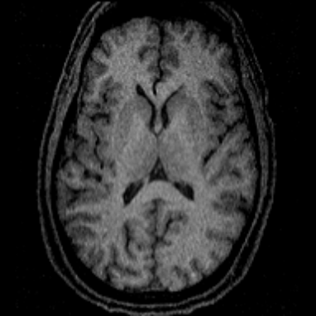
LOW
SNR

Slide 42
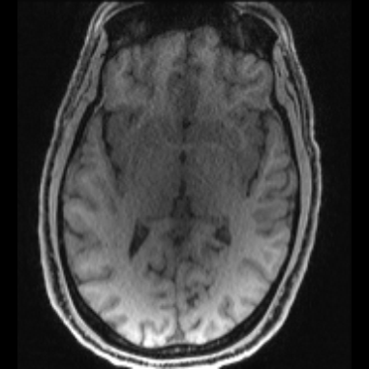
RECON
ARTIFACT
Poor SNR in central regions due to high acceleration

Slide 43
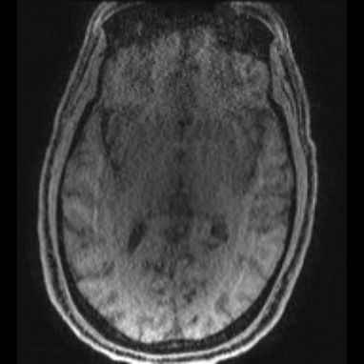
(ANOTHER)
RECON
ARTIFACT
High acceleration causing reconstruction artifacts

Slide 44
Magnetic Susceptibility Artifacts on MRI: A Hairy Situation
Robert C. McKinstry, III and Delma Y. Jarrett
American Journal of Roentgenology 2004 182:2, 532-532

Slide 45
WEEK 2
STRUCTURAL MRI
STRUCTURAL MRI
NAME THE ARTIFACT
Lynne J. Williams, Ph.D.
BCCH MRI Research Facility
Artifact images from http://www.neuroimagingprimers.org/

Slide 46
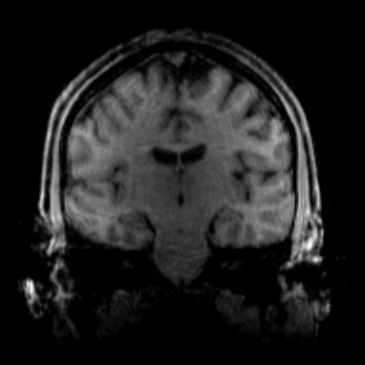
MOTION

Slide 47
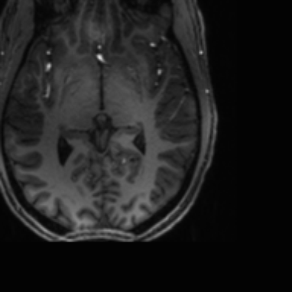
WRAP

Slide 48
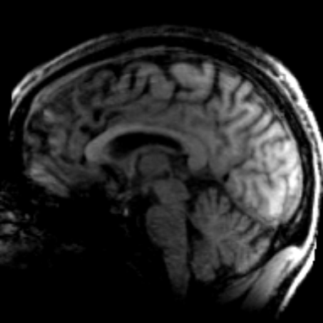
MOTION

Slide 49
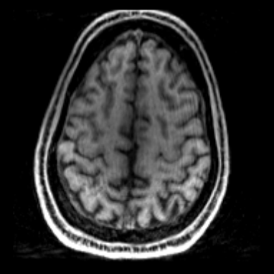
MOTION

Slide 50
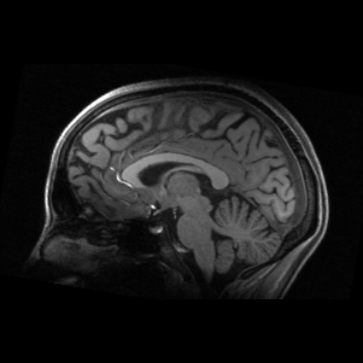
BIAS
CAN BE
CORRECTED
DURING
PREPROCESSING

Slide 51
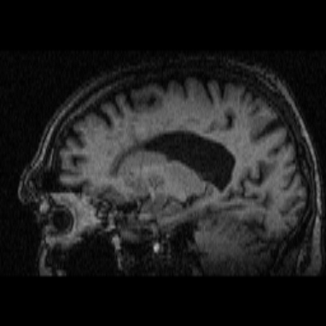
NONE
ENLARGED
VENTRICLES
Notes:
None, enlarged ventricles

Slide 52
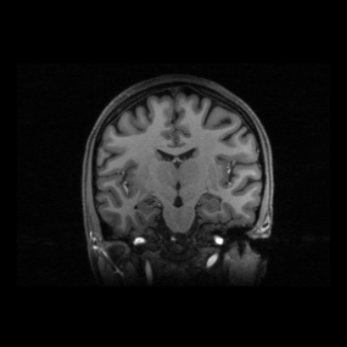
NONE

Slide 53
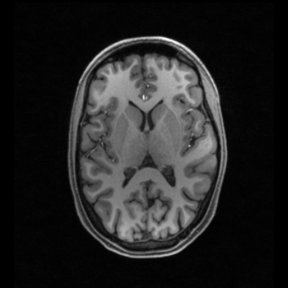
BIAS
CAN BE
CORRECTED
DURING
PREPROCESSING

Slide 54
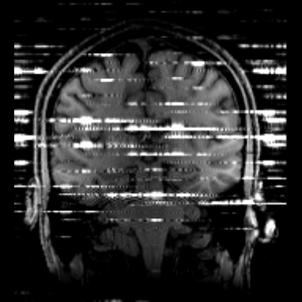
RF
ZIPPER

Slide 55
REVIEW
PROTONS PRECESS
PROTON RELEASE ENERGY
DATA GETS STORED IN K-SPACE
Spin (aka angular momentum) generates a magnetic moment that allows protons to precess at a specific resonance (Larmor) frequency in an external magnetic field (B₀)
Radio frequency (B₁) waves knock over the aligned, precessing protons. When the protons realign with B₀, they release energy at the resonance (Larmor) frequency
The relaxation rates (return to alignment with B₀) are recorded in K-space as a spatial frequencies (number of cycles per meter)

Slide 56
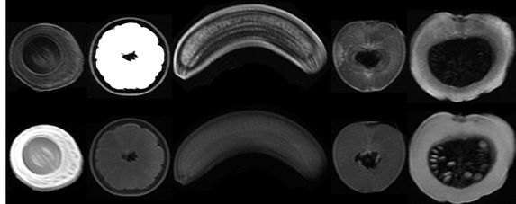
REVIEW
@lukenxie

Slide 57
REVIEW
T2
T1
@lukenxie

Slide 58
REVIEW

Slide 59
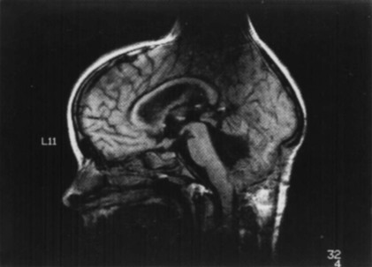
REVIEW
QUALITY
CONTROL

Slide 60
REVIEW
QUESTIONS?

Slide 61
WEEK 2
STRUCTURAL MRI
STRUCTURAL MRI
BACK TO
QUALITY CONTROL
Lynne J. Williams, Ph.D.
BCCH MRI Research Facility

Slide 62
RULE #4:
LOOK AT YOUR
DATA

QUALITATIVE AND QUANTITATIVE MEASURES NEEDED

Slide 63
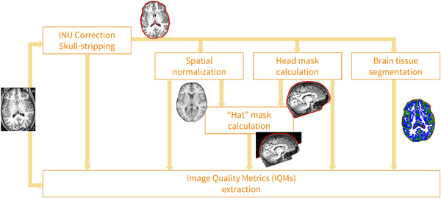

MRIQC’S PROCESSING DATA FLOW
Esteban O, Birman D, Schaer M, Koyejo OO, Poldrack RA, et al. (2017) MRIQC: Advancing the automatic prediction of image quality in MRI from unseen sites. PLOS ONE 12(9): e0184661. https://doi.org/10.1371/journal.pone.0184661
http://journals.plos.org/plosone/article?id=10.1371/journal.pone.0184661

Slide 64
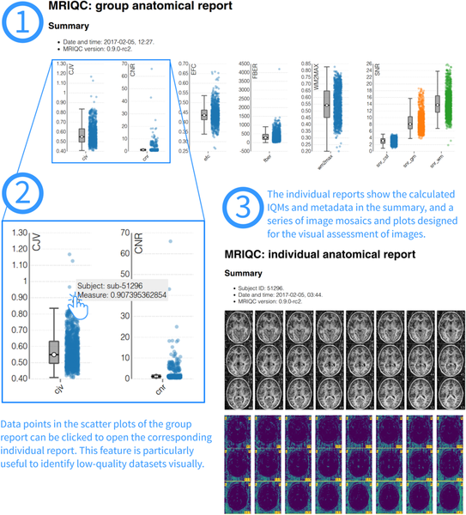
VISUAL REPORTS
Esteban O, Birman D, Schaer M, Koyejo OO, Poldrack RA, et al. (2017) MRIQC: Advancing the automatic prediction of image quality in MRI from unseen sites. PLOS ONE 12(9): e0184661. https://doi.org/10.1371/journal.pone.0184661
http://journals.plos.org/plosone/article?id=10.1371/journal.pone.0184661

Slide 65
Notes:
Signal-to-Noise Ratio (SNR) [snr]: The mean intensity within gray matter divided by the standard deviation of the values outside the brain. Higher values are better ¹.
Contrast to Noise Ratio (CNR) [cnr]: The mean of the gray matter intensity values minus the mean of the white matter intensity values divided by the standard deviation of the values outside the brain. Higher values are better ¹.
Foreground to Background Energy Ratio [fber]: The variance of voxels inside the brain divided by the variance of voxels outside the brain. Higher values are better.
Percent Artifact Voxels (Qi1) [qi1]: The proportion of voxels outside the brain with artifacts to the total number of voxels outside the brain. Lower values are better ².
Smoothness of Voxels (FWHM) [fwhm, fwhm_x, fwhm_y, fwhm_z]: The full-width half maximum (FWHM) of the spatial distribution of the image intensity values in voxel units. Lower values are better ³.
Entropy Focus Criterion (EFC) [efc]: The Shannon entropy of voxel intensities proportional to the maximum possibly entropy for a similarly sized image. Indicates ghosting and head motion-induced blurring. Lower values are better

Slide 66
WEEK 2
STRUCTURAL MRI
STRUCTURAL MRI
PROCESSING PIPELINES
Lynne J. Williams, Ph.D.
BCCH MRI Research Facility

Slide 68
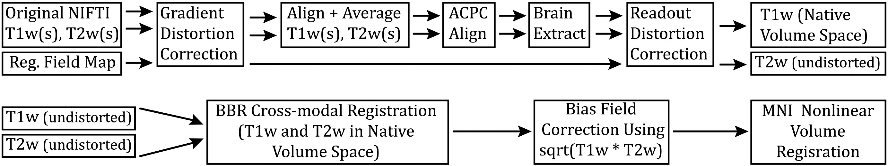
HCP PRE-FREESURFER PIPELINE

Slide 69
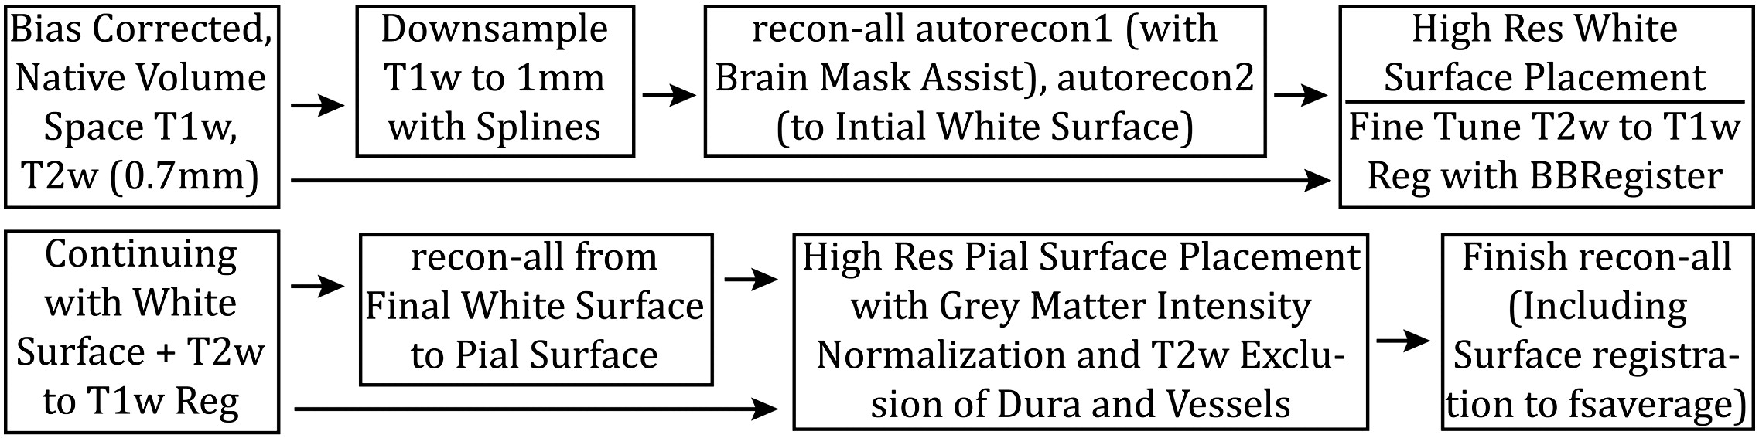
HCP FREESURFER PIPELINE

Slide 70





© 2018 BC CHILDREN’S HOSPITAL MRI RESEARCH FACILITY
This work is licensed under the Creative Commons Attribution-NONCOMMERCIAL-ShareAlike 4.0 International License. To view a copy of this license, visit http://creativecommons.org/licenses/by-nc-sa/4.0/..
THANK YOU
BCCH MRI Research Facility

Slide 71
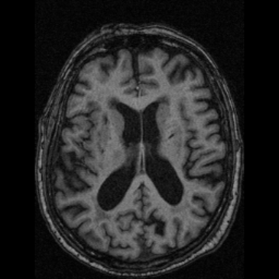
NONE
ENLARGED
VENTRICLES
Notes:
None, enlarged ventricles

Slide 72
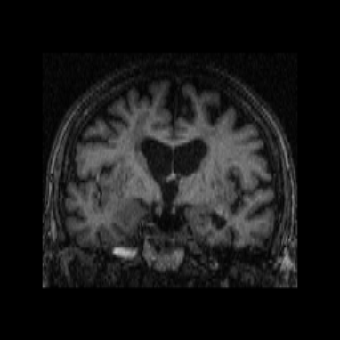
NONE
ENLARGED
VENTRICLES
Notes:
None, enlarged ventricles

Slide 73
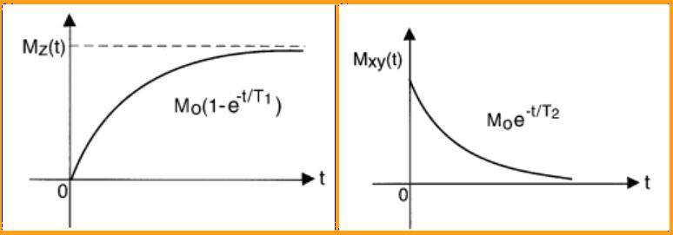
PROTON DENSITY
T1 provides insight into the repetition time
T2 is directly related to the lifetime of the excited state

Slide 74
T1 vs T2
T1 provides insight into the repetition time
T2 is directly related to the lifetime of the excited state

Slide 75
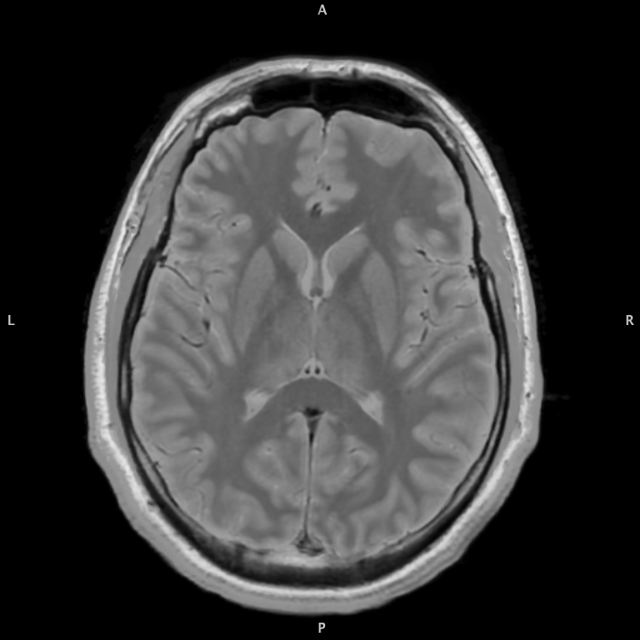
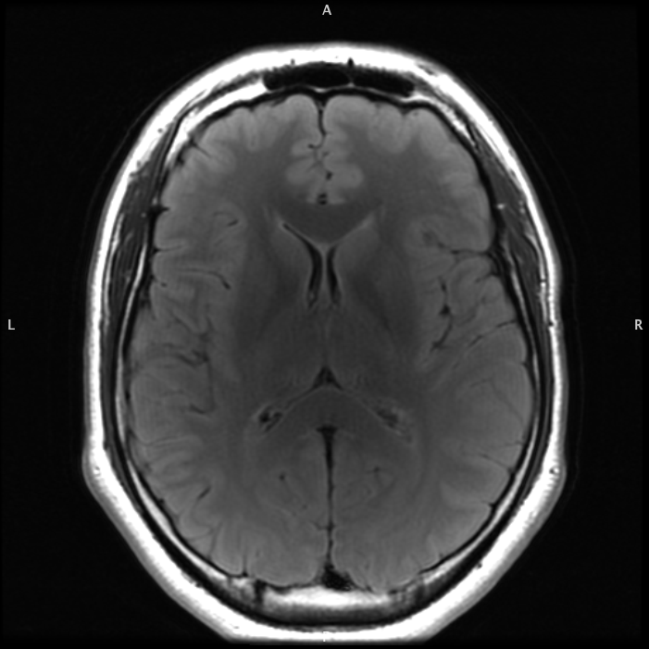
T1
T2
EXAMPLES
OF COMMON
STRUCTURAL
SCANS
PD
T2 FLAIR
Note that the T2 FLAIR scan came from a different scan session (although all from the same individual)
Slide / 01
www.yourwebsite.com

Slide 76
YOUR TITLE
HERE
Far far away, behind the word mountains, far from the countries Vokalia and Consonantia, there live the blind texts. Separated they live in Bookmarksgrove right at the coast of the Semantics, a large language ocean.

Slide 77
YOUR
TITLE HERE
Far far away, behind the word mountains, far from the countries Vokalia and Consonantia, there live the blind texts. Separated they live in Bookmarksgrove right at the coast of the Semantics, a large language ocean.
- The Quotes
Far far away, behind the word mountains, far from the countries Vokalia and Consonantia, there live the blind texts. Separated they live in Bookmarksgrove right at the coast of the Semantics, a large language ocean.
- The Quotes
Notes:
TR and TE HERE!!!!!

Slide 78
Short TE
Long TE
T1
EXAMPLES
OF HOW SCAN
MODALIES
RELATE TO
TR & TE
Poor CNR & SNR
Not done in practice
Short TR
PD
T2
Sign
Long TR

Slide 79
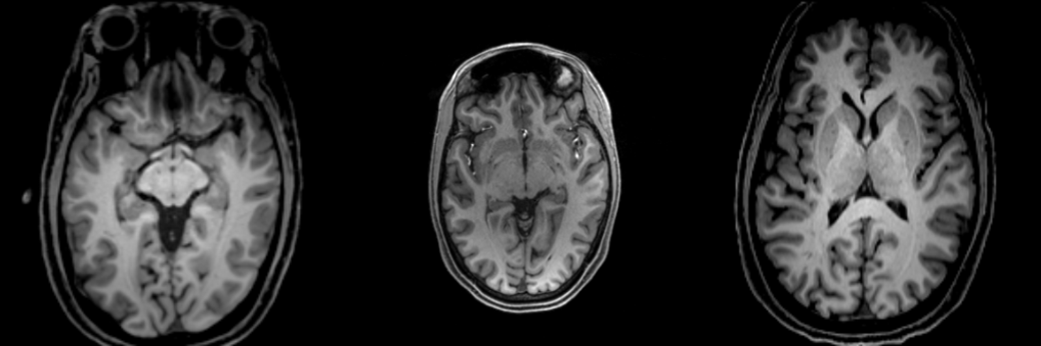
ACCEPTABLE
T1 SCANS
YOUR TITLE
Far far away, behind the word mountains, far from the countries Vokalia and Consonantia, there live the blind texts.
85%
Far far away, behind the word mountains, far from the countries Vokalia and Consonantia, there live the blind texts.
Slide / 01

Slide 80
© 2018 BC CHILDREN’S HOSPITAL MRI RESEARCH FACILITY
This work is licensed under the Creative Commons Attribution-NONCOMMERCIAL-ShareAlike 4.0 International License. To view a copy of this license, visit http://creativecommons.org/licenses/by-nc-sa/4.0/..
THANK YOU
BCCH MRI Research Facility

